Slide 1


Wednesday, November 2nd

Slide 2
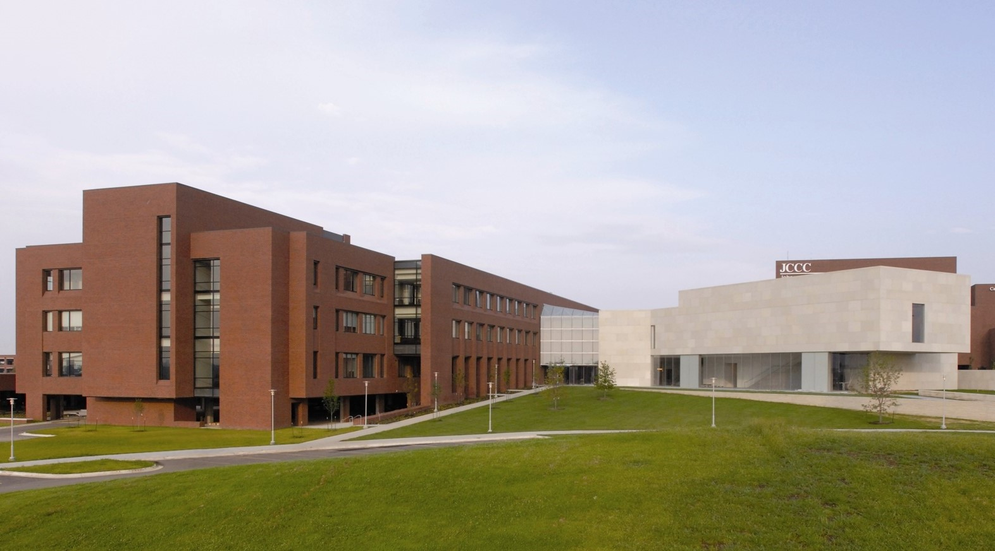
Johnson County Community College
Depart Oregon Trail: 1:30pm
Time at Career Expo: 1:55-2:35pm

Slide 3
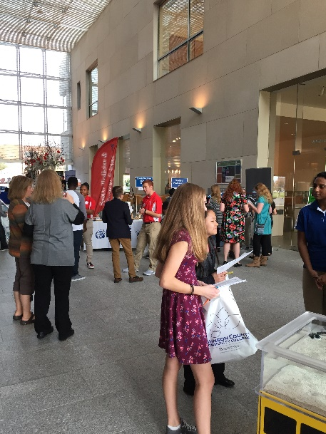
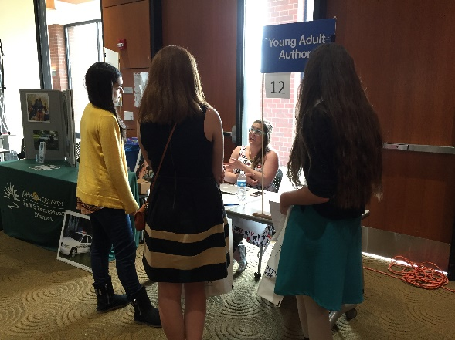
Objectives:
Students attending Career EXPO will…
Speak with community career representatives who match their career interests.
Learn post-secondary requirements for their careers of interest.
Connect Xello Matchmaker results with academic and career goals.
Demonstrate effective and respectful verbal and nonverbal communication.

Slide 4
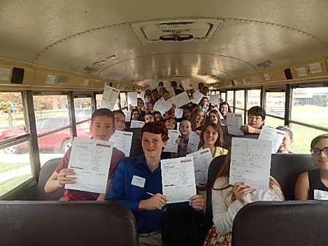
Career EXPO Format
40 minute interactive sessions with career representatives
40-50 Career representatives available for students
Completion of Rep Interviews & Response Card

Slide 5
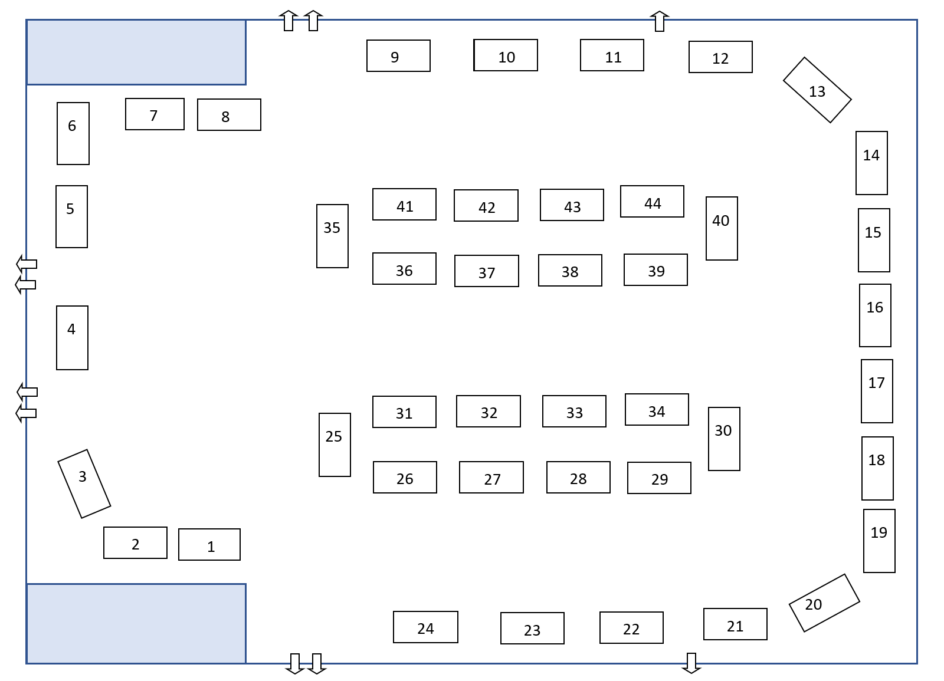
Cap Fed Room
Students Prepared for Their Future

Slide 6
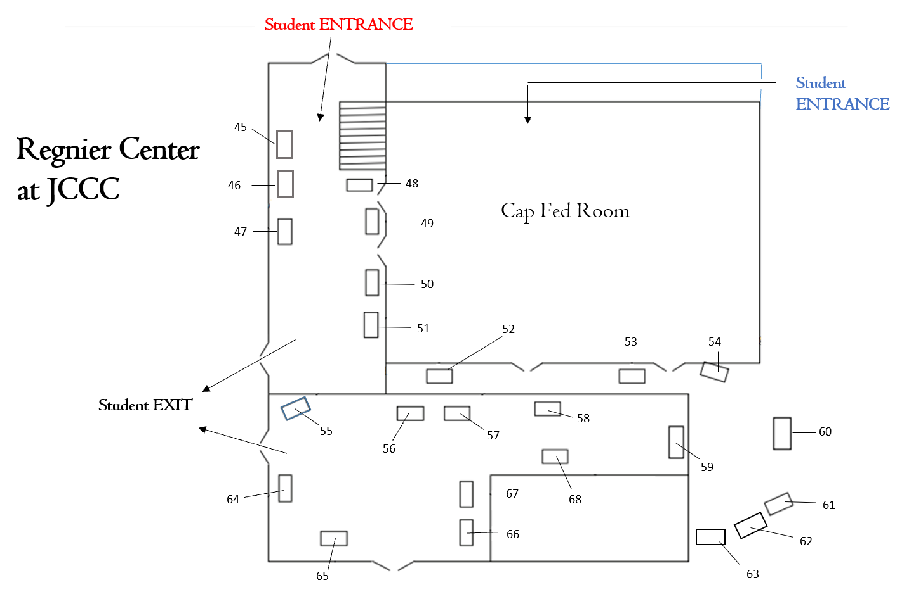
Hall/Atrium

Slide 7
Table Numbers & Career
JoCo MED-ACT (paramedic)
Department of Emergency Services
3. Olathe Fire Department
JoCo Sheriff’s Seargeant & Crime Lab
Olathe Police Department SRO
Educator
Library Media Specialist
City of Olathe
Injury/Trial Lawyer
Veterinarian
Lawn/Landscape Construction
Recreation Programming Olathe Parks & Red
Environmental/Water Services, City of Olathe
Photographer
Software Engineer/Front-end Developer
Graphic Design
Studio Art Director, Hallmark
Professional Freelance Artist
Data Architect
IT/Database Creator
Prenatal/Reproductive Genetic Counselor
Rehab Services (PT/OT/SLP/ATC)
FBI – Special Agent/Operational Support
Coroner/Medical Examiner/Medical Investigator
Prosthetics/Orthotics
Healthcare Careers
Professional Musician
31. Esthetician (Skin Therapist)
32. School Psychologist
33. Insurance
34. Realtor
35. Court Reporters / Stenographers
36. Fashion Design & Merchandising
37. Food Science/Animal Science/Biosecurity
38. Children’s Advocacy Center
39.
40. Computer Science/IT/Game & Web Development
41. District Attorney
42. Landscape Architecture
43. Meteorologist
44. Experience Production – KC Zoo Careers
45.
46.
47. Financial Advisor
48. Auto Dealer
49. Public Works
50/51. Dance Professional
52. General Contractor
53. Traffic Operations – City of Olathe
54. Assistant City Engineer – City of Olathe
55. Civil Engineer
56. Civil Engineer & Transportation Careers
57. Civil Engineer & Construction
58. Sales Engineer / Industrial Automation
59. Civil Engineer
60. Ford Recruiter & Field Service Engineer
61.
62.
63.
64. FAA Operations
65. Air Traffic Controllers
66. Mechanical Engineer
67.
68. Master Plumber

Slide 8


Slide 9


Table 1: Paramedic
Table 10: Veterinarian
Table 23: Prenatal/Reproductive Genetic Counselor
Table 24: Rehab Services (PT/OT/SLP/ATC)
Table 26: Coroner/Medical Examiner/Medical Investigator
Table 27: Prosthetics
Table 28: Healthcare Careers

Slide 10
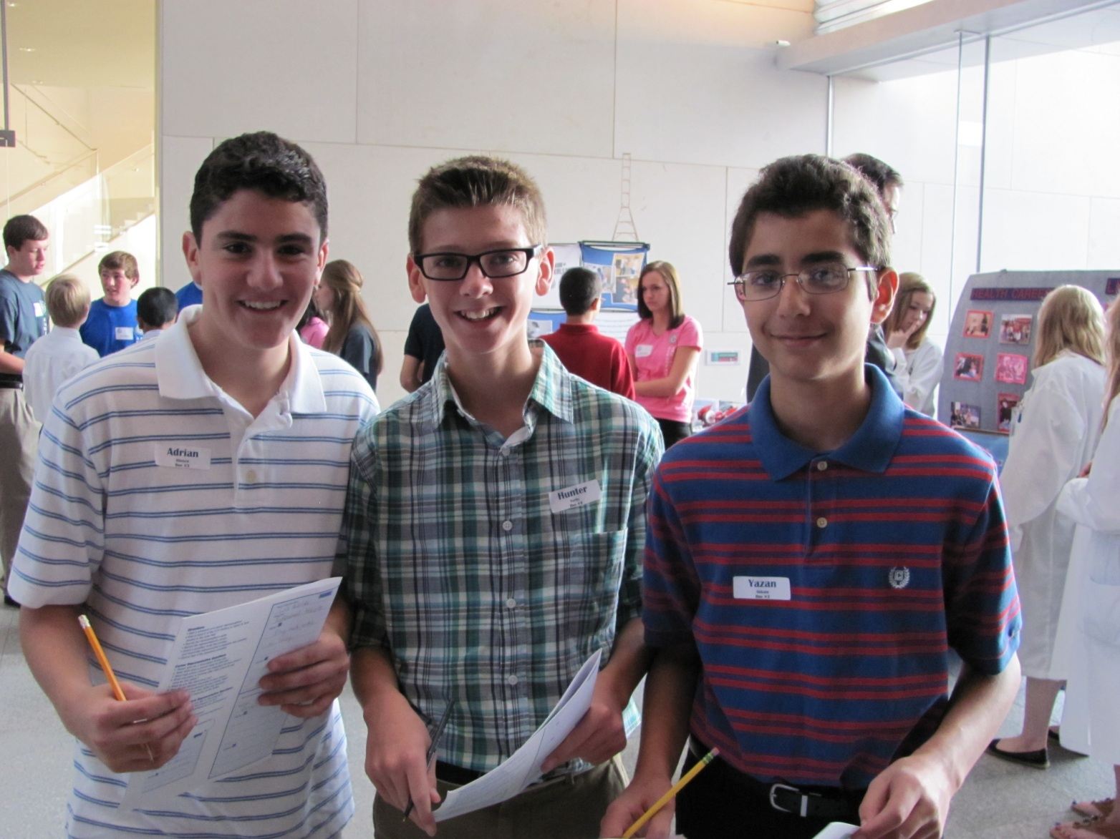
EXPO Activity Instructions

Slide 11
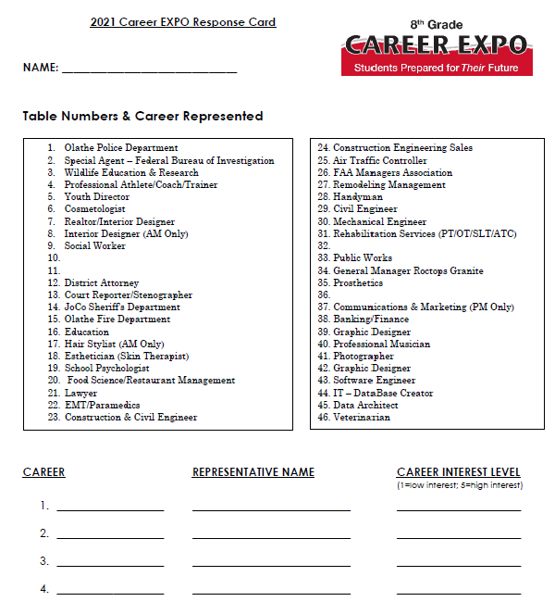
Career EXPO Activity
Visit FOUR career representatives
Use the EXPO Student Response card to record your interviews
Write down the person’s name (first AND last) and career title
You will find sample questions to ask on your EXPO card

Slide 12
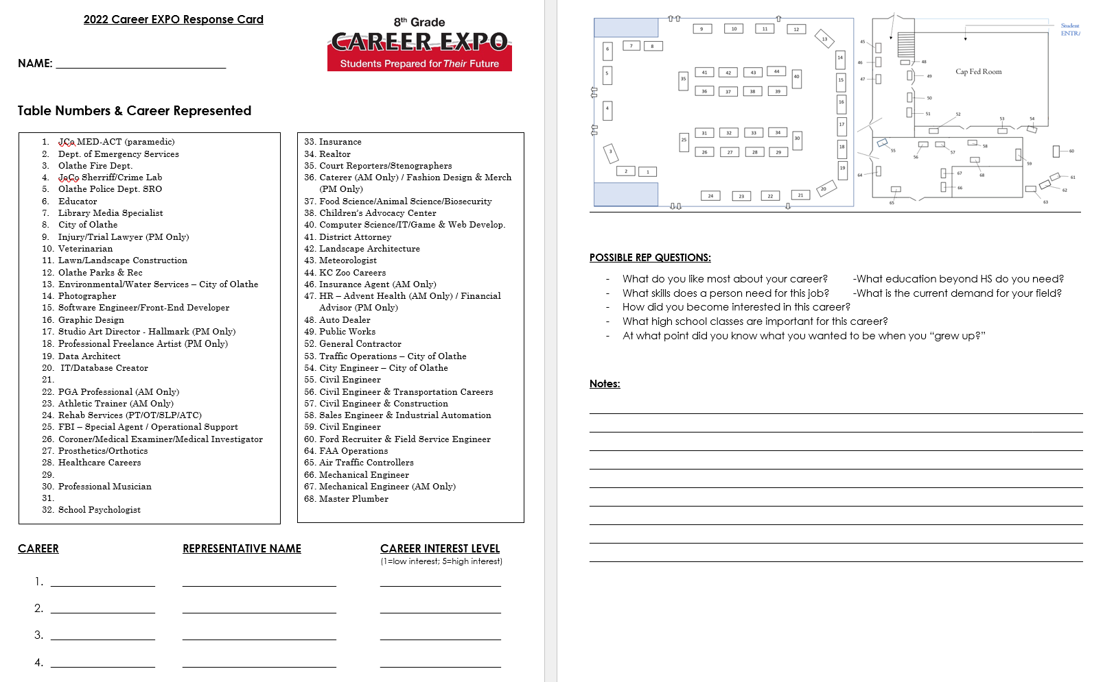
Student Response Card

Slide 13
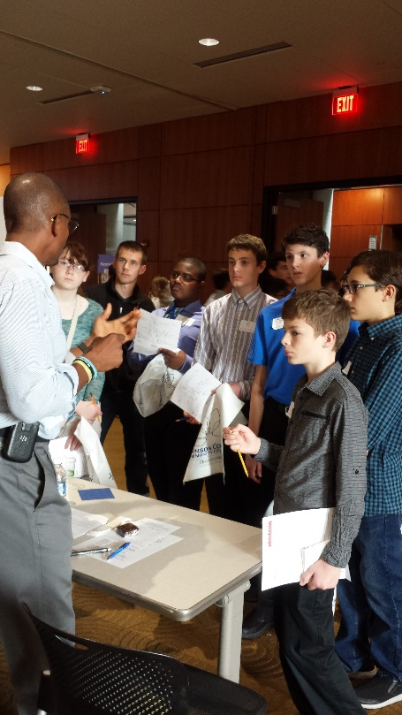
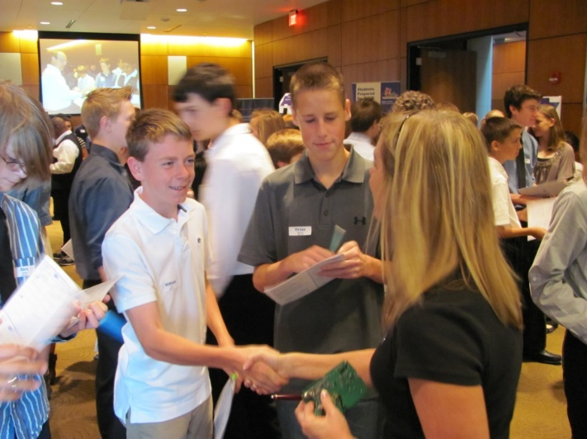
A Professional Experience
Student Expectations
First impressions are lasting impressions!
-Appropriate attire
-Appropriate behavior
-Verbal and nonverbal etiquette
-Proper introduction
-Maintain eye contact
-NO gum or cell phones!
-Handshake *demonstration
Express gratitude – thank the person for their time
Remember that this is a networking opportunity!

Slide 14
A Follow Up
“Thank You” Note
Upon returning to OT, you will write a thank you note to one Career Representative
Make sure the person’s name is spelled correctly
The content of the note is positive and appropriate!

