Slide 1
xello
Matchmaker
(39 questions)
Matchmaker Reflection

Slide 2

Let’s begin by watching…

Slide 3
TODAY’S GOALS
WHY ARE WE DOING THIS?
Learn how your interests and skills help determine a career by completing Matchmaker.
After completing Matchmaker, you will save at least three careers that are of interest to you.
Complete the Matchmaker reflection.

Slide 4
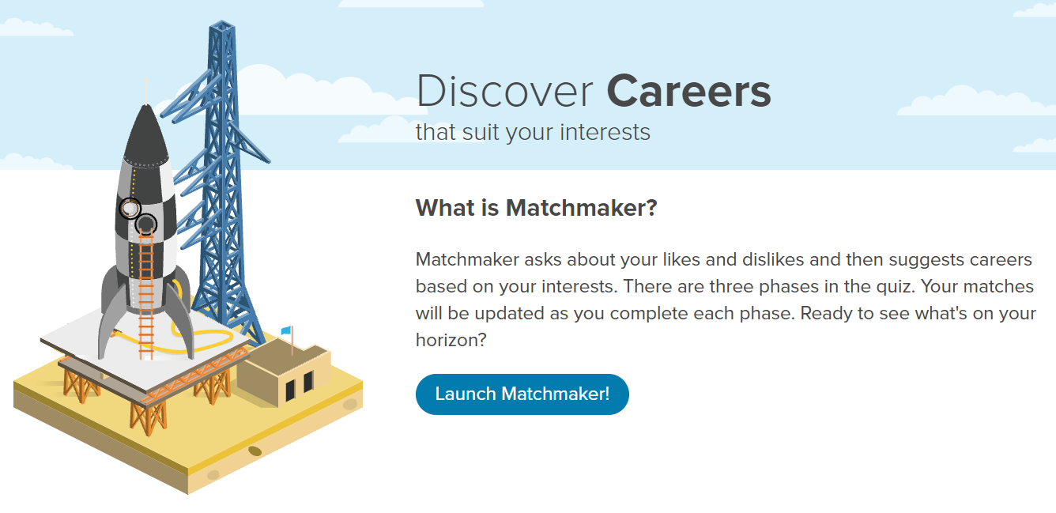

Slide 5
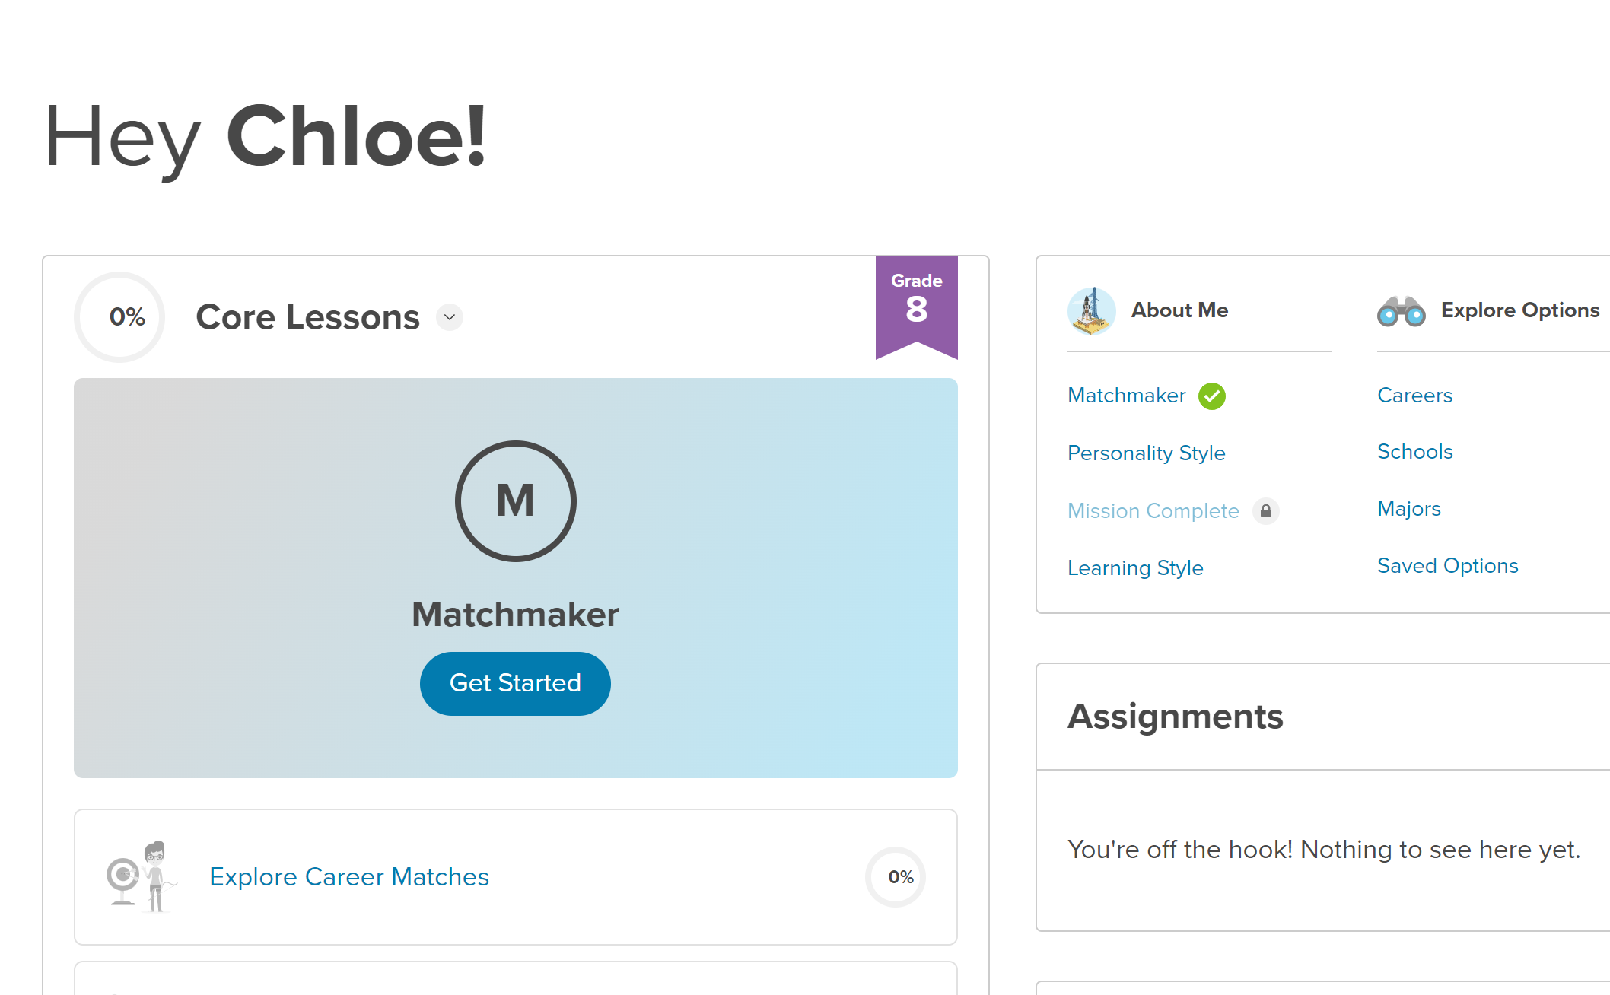

Slide 6
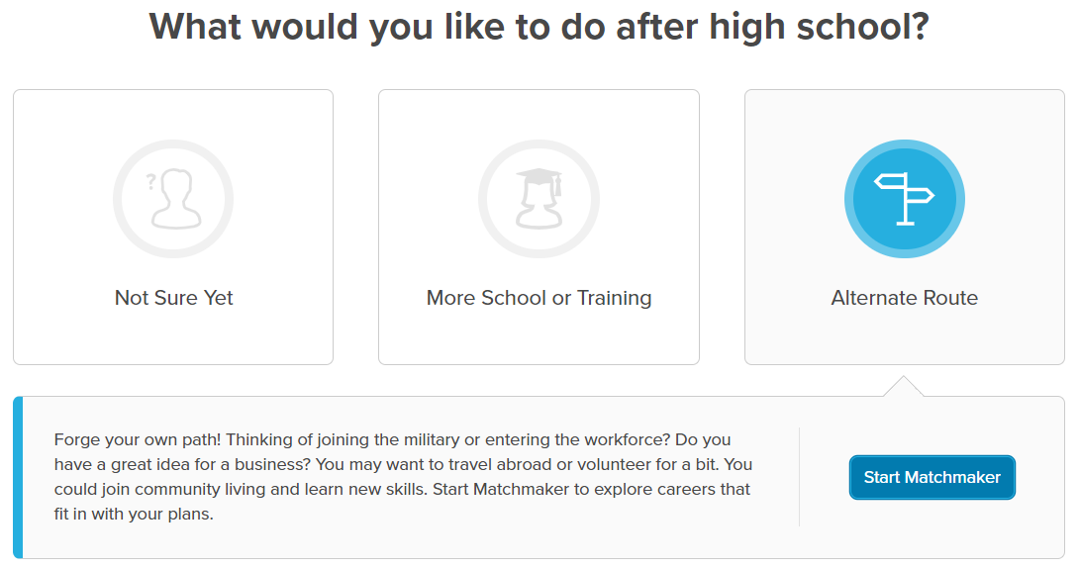
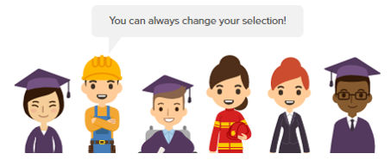

Slide 7
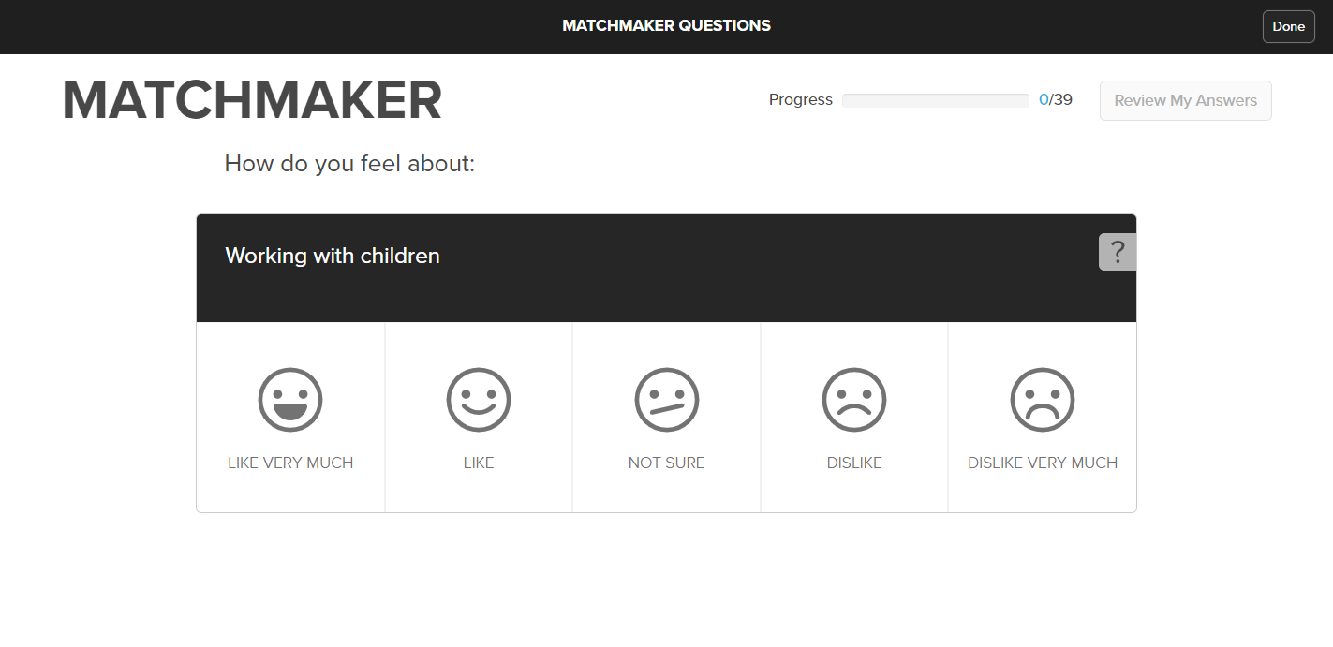
If you click the wrong answer on accident, you can change it here.
Try not to click on this one!

Slide 8
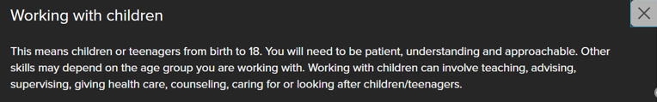

Slide 9

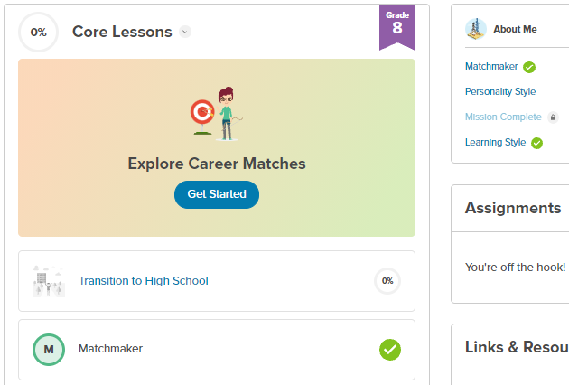
Directions
TO DO:
WHEN FINISHED:
Step 1: Matchmaker
Step 2: Save 3 Careers
You can save as many careers as you want!
Step 3: Matchmaker Reflection
Remember to click “Turn in”
Step 4: Show Ms. Smith or Mrs. Rodden your screen!
Raise your hand – Ms. Smith or Mrs. Rodden need to check your screen!

Slide 10
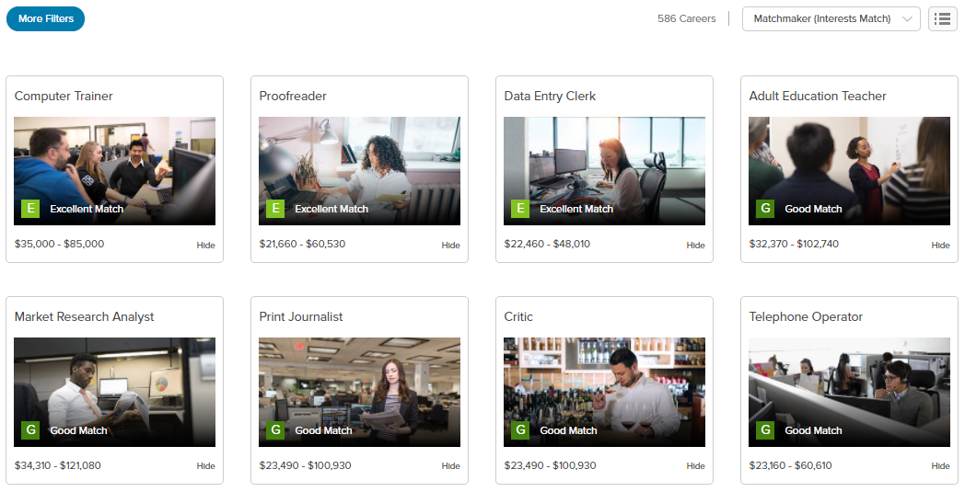

Slide 11
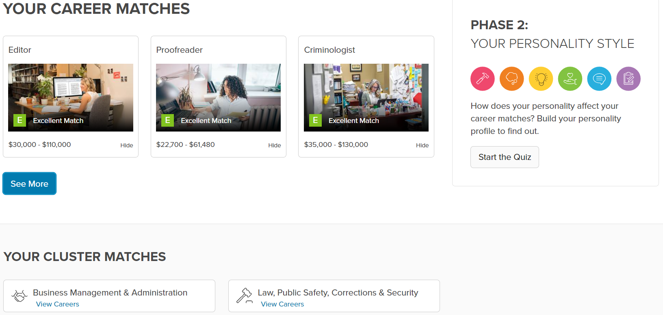

Slide 12
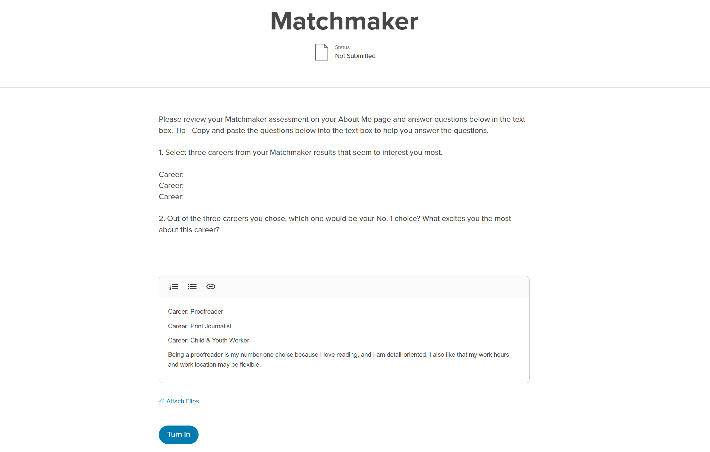

Slide 13
Directions
TO DO:
WHEN FINISHED:
Step 1: Matchmaker
Step 2: Save 3 Careers
You can save as many careers as you want!
Step 3: Matchmaker Reflection
Remember to click “Turn in”
Step 4: Show Ms. Smith or Mrs. Rodden your screen!
Raise your hand – Ms. Smith or Mrs. Rodden need to check your screen!

Slide 14
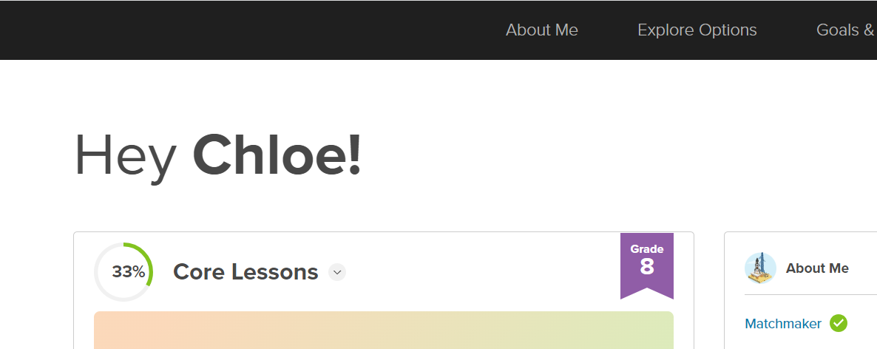
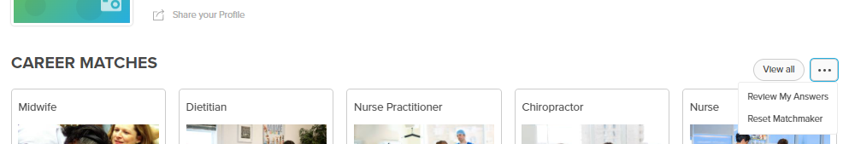
To reset career matchmaker:
Click on About Me:
Click the three dots:

Slide 15
